Slide 1
DEPARTMENT OF S PRAYAS CERTIFIED JAVA FULL STACK DEVELOPER
EDUBRIDGE INDIA PRIVATE LIMITTED 2021-2022
PRESENTATION FOR
“EMAIL ADMINISTRATION”
SUBMITTED BY
MISS: D. ISHA
Batch No: EON-5755
Under The Guidance Of
Amruta Deore

Slide 2
ABSTRACT
This is the project for Email Administration . Email is an important method of business communication that is fast ,cheap ,accessible and easily replicated .Using email can greatly benefit business as it provides efficient and effective ways to transmit all kinds of electronic data.

Slide 3
INTRODUCTION
The objective of Email administration is to develop a new and unique email id for each and every students for their first and last name based. And it is very useful to identify students details.
this is very useful to make a process very easy .and it this project I have used one method to generate email id based the particular students given details . then I have use set department method ,this is very useful to generate a email with the department code.
In this project I have used more then 5 methods to make a perfect email administration project . we will see all the methods details in following slides

Slide 4
MODULES
I have used some methods to create a Email administration project we will see all the method in below.
Set Department
Generate Email
random password
Set password
Set Mail Capacity

Slide 5
Generate Email
I have used this method to generate email for each new students . its is based on user first name and last name . and I get input from the user in run time.

Slide 6
SET DEPARTMENT
I have used this set department method to make the list of departments. it is very useful to select department ,and it is very useful to generate the Email with the department details.

Slide 7
Random Password
I have used this method to generate random password for each and every students .with the help of random password we can make our app is secure .with the help of random key word I have made this generate random password method.

Slide 8
Set Password
This method is very useful to set password.in this method we get a run time password from the user in run times . if suppose anyone feels my random password is not good ,its difficult I couldn’t remember that . that’s the time the user can set their own password in run time .so that this method is very useful .

Slide 9
Mail Capacity
I have used mail capacity method to set the capacity of mailbox . and I have made this method to get the value from the users because everyone need don’t need same size of mailbox ,so that I have made it get the input from the users in run time.

Slide 10
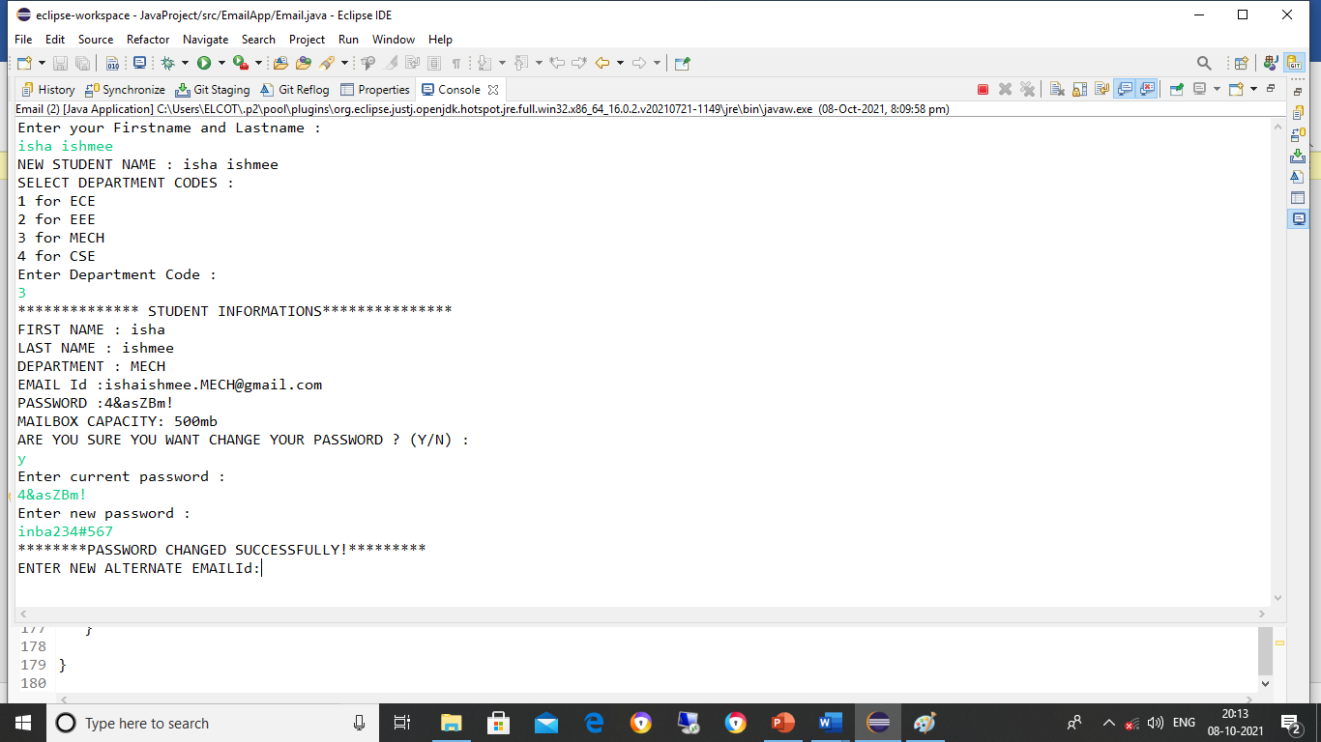
SCREEN 1 :

Slide 11
SCREEN 2 :

Slide 12
SCREEN 3 :

Slide 13
SCREEN 4 :

Slide 14
Advantages Email Administration
Easy access to manage employee information.
Eco-Friendly : Paper work can be avoided
Efficient control over employee data.
Cost-efficient and User-friendly.

Slide 15
CONCLUSION
The email administration project is very useful to easy referencing and email is accessible from anywhere-as long as you have an internet connection . And it is paperless with the help of email administration we can create specific mail id and password for each and every candidates, so its very secure and useful.

Slide 16
Thank You

